Slide 1
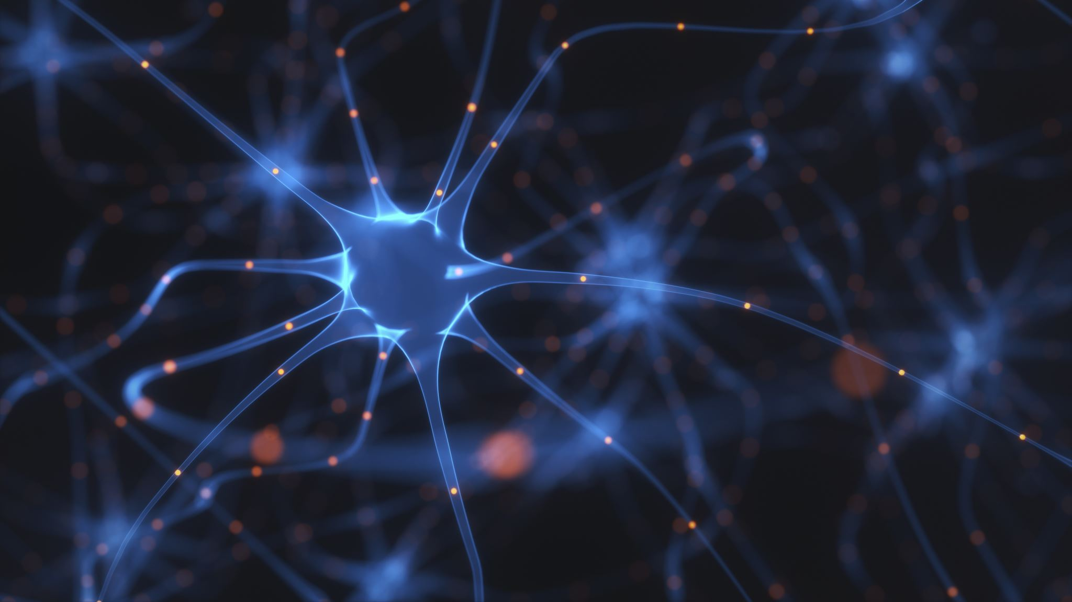
Neural Networks
By:
Arnesha Nicholas
Oruru Nathanael
DeAndre Johnson

Slide 2
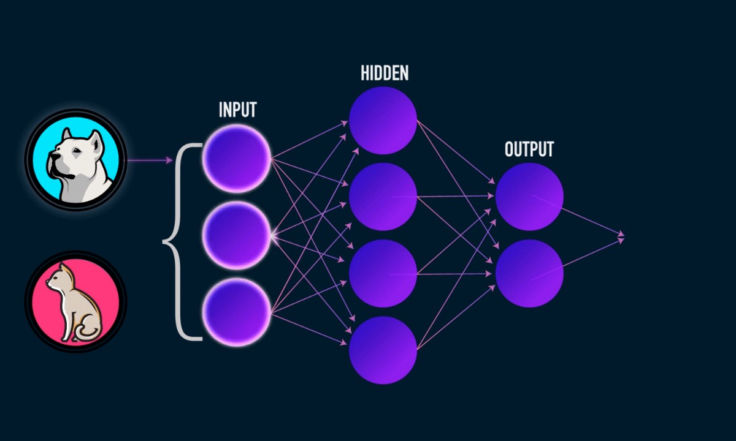
Neural network overview
A neural network is a type of network architecture that consists of inputs and outputs in the form of a neurons or nodes.
The goal of neural networking is to map those inputs to a particular output and in the case of our model the input will be pictures of dogs and cats and the output will consist of determining whether the specified image is a dog or cat

Slide 3
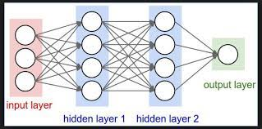
Neural network overview continued
Neural networks also consist of hidden layers or simply layers to help map the input data to the output. A neural network is considered a deep neural network if there are two or more layers.

Slide 4
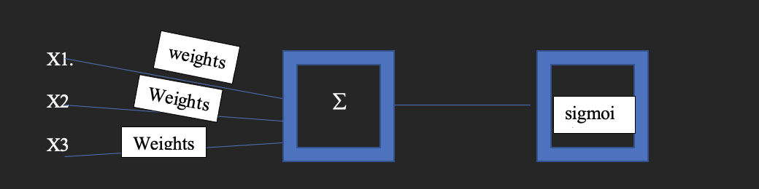
What happens in each individual neuron?
Once data is passed, whether it be from the input or a neuron from the hidden layer we take a summation from the unique weights multiplied against the it’s attached data and pass the results to an activation function. This process simulates a neuron firing or not firing

Slide 5
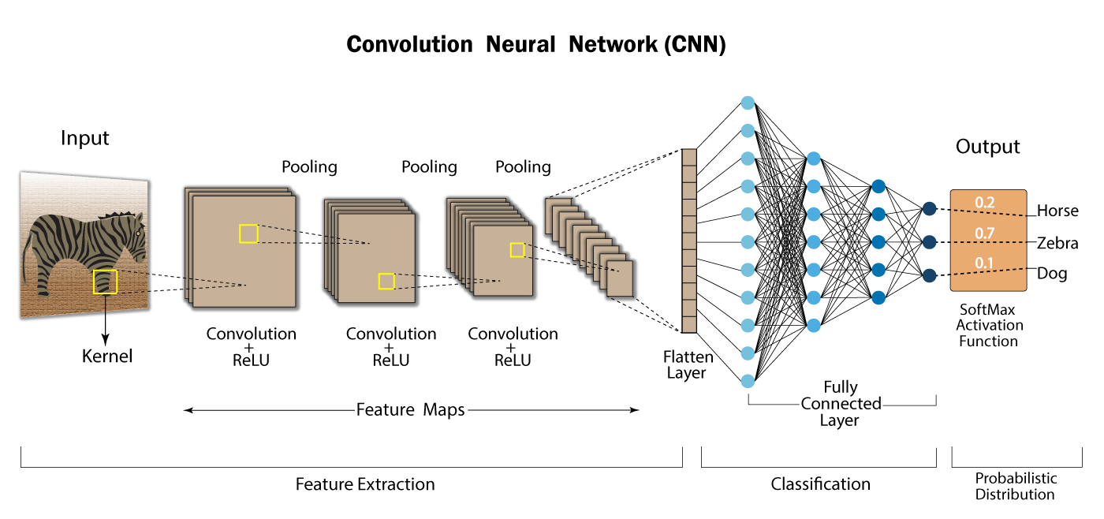
Convolutional neural network
A convolutional Neural network is a Network architecture that is derived from Neural networks which have have multiple layers where each layer passes a convolved image as input to the next layer.

Slide 6
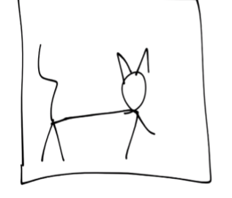
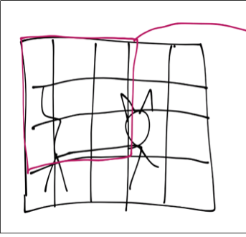
How does our CNN work?
We take an image and convert the image to pixel data; we then take a X by Y convolutional window and inside this window the convolution will then try to simplify the data in that particular widow down to a certain value then the window will shift over and proceed to do the process over again.

Slide 7
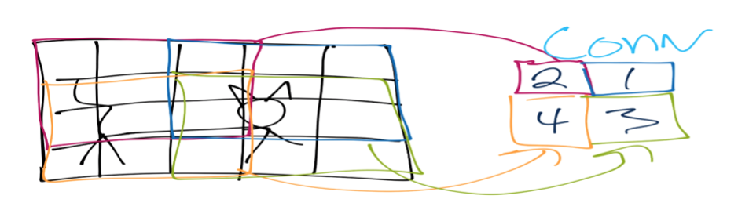
Continued.
we continue the sliding window process until the entire image is covered producing a feature map of simplified pixel data from the convolutions.

Slide 8
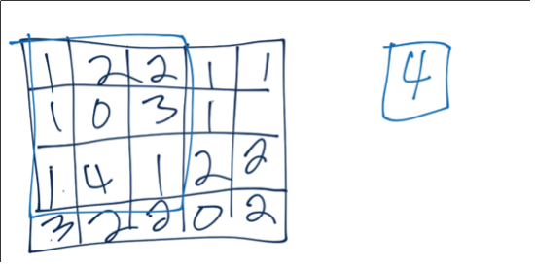
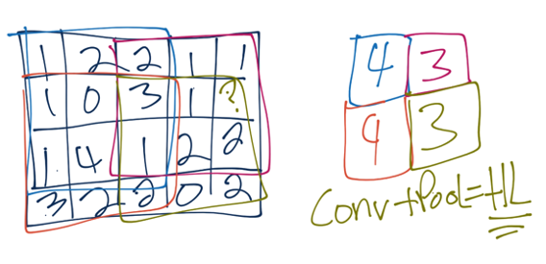
Continued.
After the feature map is produced, we do a pooling layer which includes a max pooling window that simply extracts the max value inside a X by Y window that is in the feature map produced by the convolutions.

Slide 9
Problem Statement
We want to use images of dogs and cats for a Neural Network model to determine how well the model will predict the images of dogs and cats.

Slide 10
Steps In Our Research
1. Prepare Workspace on Jupyter Notebook
Import dataset
Clean the data
2. Create data model:
Train model
Split data into two:
Training Data
Prediction Data
3. Divide training data into two:
Training data: 70%
Test Accuracy: 30%
4. Computer Vision:
Make a prediction using a dataset without labels(prediction data):
Evaluate & Improve.

Slide 11
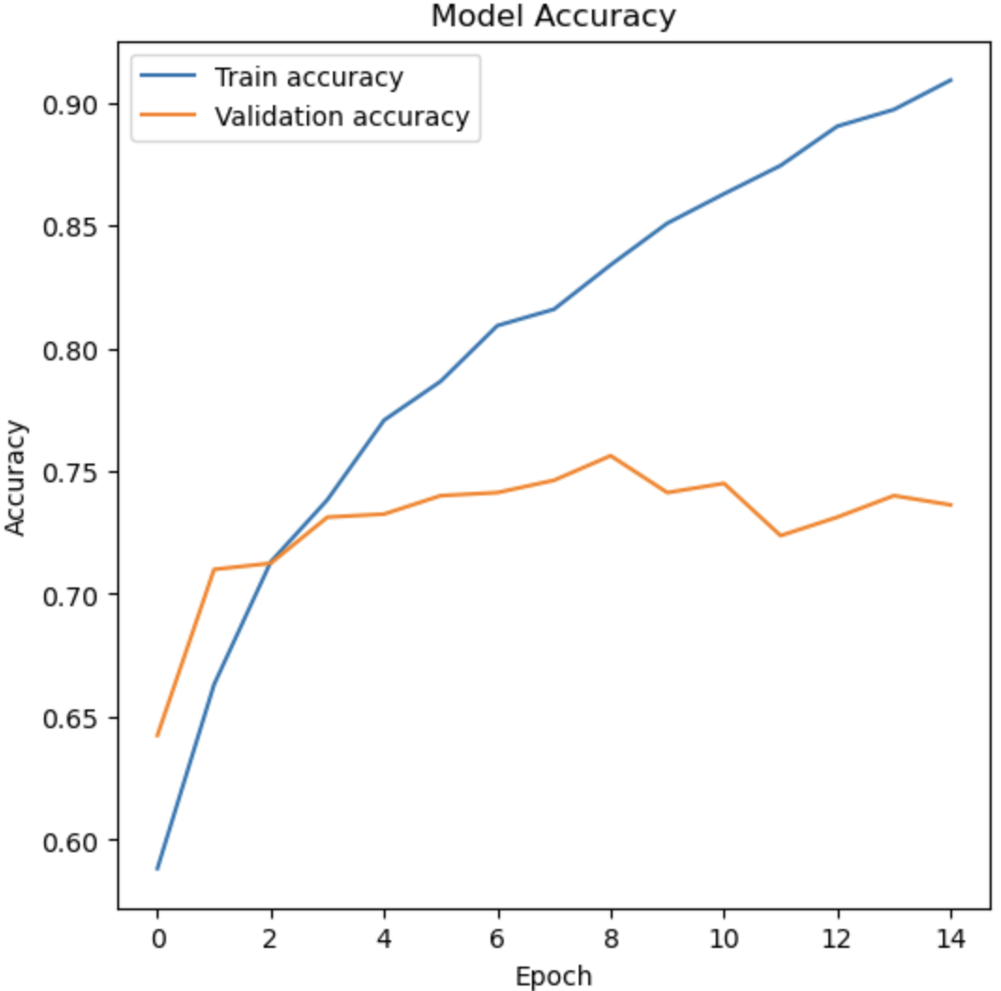
How the model helps make image recognition better?
Our model helps make image recognition better by recognizing patterns and it's inspired by the human structure.
By looking at the accuracy of our model we know that the image was very well recognized by 90%.

Slide 12
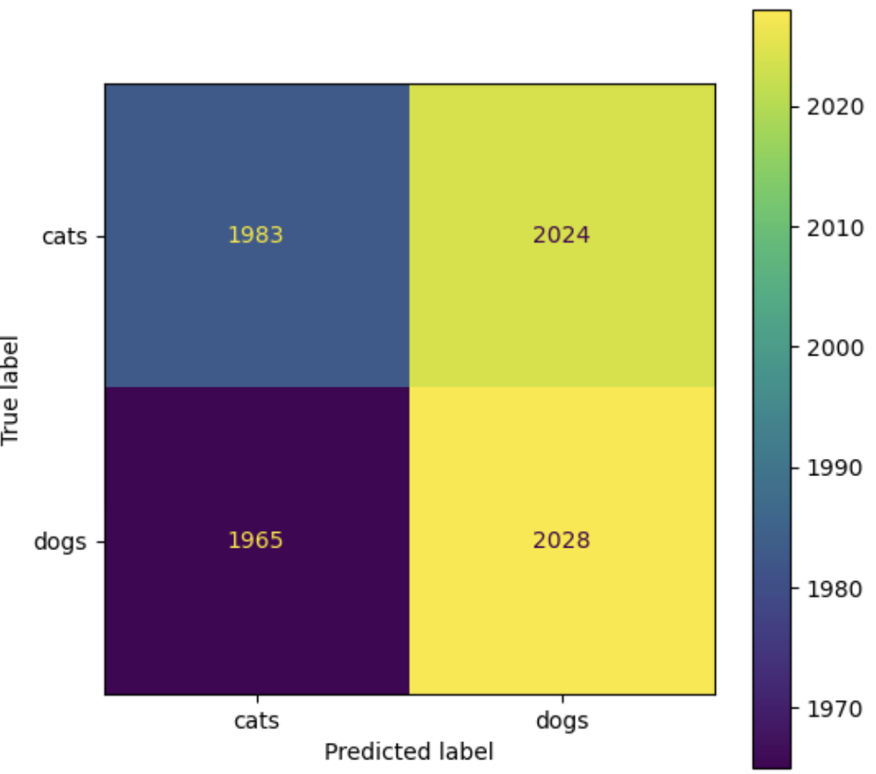
Conclusion
The model is adjusting with the pictures by making the predictions by what is it thinking of what its seeing and what is it actual seeing.

